Slide 1
UNIT 1- PROGRAMMING FUNDAMENTALS
UNIT 1.4: LOOPS CONT: WHILE LOOP, WHAT IS A FUNCTION, HOW TO WRITE A FUNCTION IN JAVASCRIPT, FUNCTION CALLS, FUNCTION ARGUMENTS, FUNCTION PARAMETERS

Slide 2
Learning Objectives
By the end of this lecture, students will be able to
Describe while loops
Use while loops
Describe and identify functions
Write functions in JavaScript
Identify function calls
Differentiate between function calls and function arguments
Local Vs global scope
Block scope

Slide 3
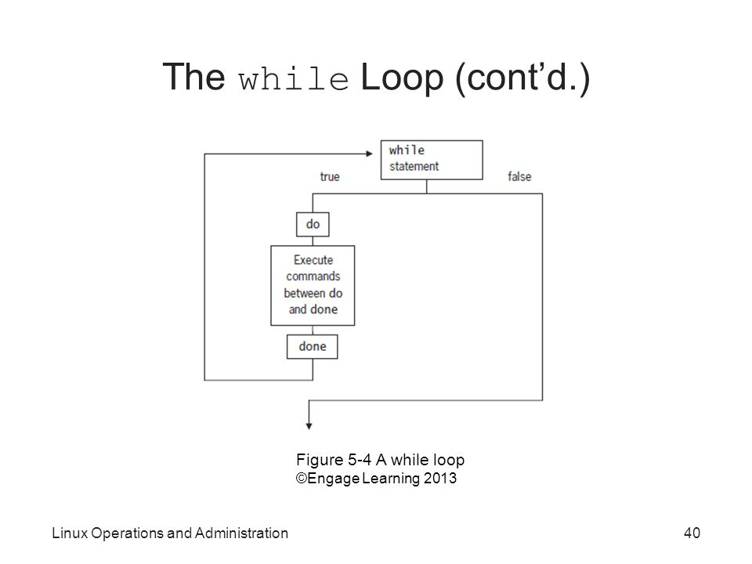
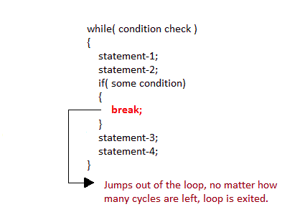
While Loop- Structure
As long as the condition is true, code is executed.
When break statement is encountered inside a loop, the loop is immediately exited and the program continues with the statement immediately following the loop.

Slide 4
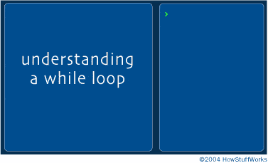
While Loop- Structure
when the computer reaches the while statement, it tests to see if the boolean expression is true. If true, it jumps into the block of code immediately below the while statement.
when the computer reaches the last line in the while loops block of code, it jumps back up to the while statement. It retest the boolean expression. If still true, it enters the block of code again.
When the boolean expression becomes false, the computer skips the while statement and continues with the remainder of the program.

Slide 5
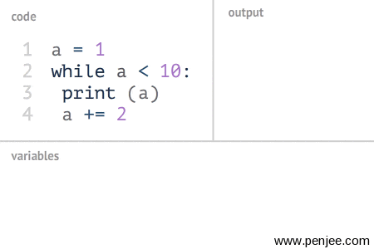
While Loop- Syntax
The following is an example of a While loop that iterates a series of numbers as long as it is less than 10. It is adding +2 to the var a after every iteration.
Note: the print statement is python syntax.

Slide 6
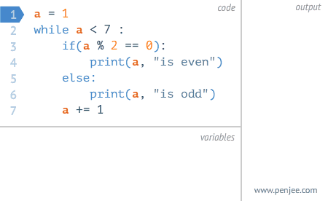
While Loop- Syntax
The following is an example of a While loop that iterates a series of numbers as long as it is less than 7. It is also running an if statement to check if the var a if divisible by 2 with no remainder and printing it with a string “ is even”
else “is odd”

Slide 7
While Loop- Example
Use when you need to run the same code as long as a condition is true
Let’s write a while loop to count down to 0
Starting anywhere between 5 and 10
What would be condition for count down that needs to be true?
number greater than 10?
Number less than 10?
Number greater than 0?
What do you think?
Notes:
Bash While loop examples
https://www.cyberciti.biz/faq/bash-while-loop/

Slide 8
Syntax
Initialize your variable:
var i=1;
while(Condition){
console.log(“Hello”)
i ++;
}

Slide 9
Task
Keep printing integers multiples of 3 as long as integers are less than 35

Slide 10
Task
console.log("Task: while loop. Print multiples of 3 as long as it's < 35");
var i = 1
while( i < 35){
// i = i * 3
console.log(i* 3)
i ++;
}

Slide 11
Task
Keep printing integers multiples of 5 as long as integers are less than 100

Slide 12
Task
console.log("Task: while loop. Print multiples of 3 as long as it's < 35");
var i = 1
while( i < 100){
// i = i * 3
console.log(i* 3)
i ++;
}

Slide 13
Task
Using a while loop print integers between 0 and 20. All numbers divisible by 2 should be multiplied by 3 before they are output. All other integers should not be output.
Hint: use Modulus

Slide 14
Task
Using a while loop, print out all prime numbers between 0 - 20

Slide 15
BONUS - Logical Question
Nando went to the vending machine to buy himself a cookie. The cookie costs $4 dollars. He paid with a $10 bill, the vending machine paid him back in quarters. Write a loop that says how many quarters he got in return.
Notes:
See answer here: https://drive.google.com/a/perscholas.org/file/d/0B7FQLtsT2oqzdGxCVWtWd0IyRWc/view?usp=sharing

Slide 16
FUNCTIONS

Slide 17
Functions
A block of code enclosed in braces { }
Is used when same lines of code are being used multiple times throughout the program
That block is declared as function using the right keyword

Slide 18
Function cont.
If your goal was to add different combinations of two outputs of four variables x, y, z, w and add 3.
one way is to add variables and add 3 every time it’s required.
(x+y+z+w)+3;
Second way is to write a function, which means write the code only once and use it as many times as required.
function add(x,y,z,w){
(x+y+z+w)+3;
}
add(4,5,6,7);
Which method is time saving?

Slide 19
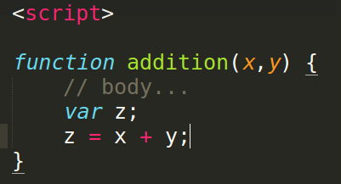
Functions in JavaScript
Functions in JS look like this
is declared by the keyword function
Keyword is followed by the name
Name is followed by the parameters
{ indicates the beginning of the block
} indicates the end of the block

Slide 20
Functions - ES5 vs. ES6
//ES5
function addition(x, y) {
var z;
z = x + y;
return z;
}
console.log(addition(2, 4));
//ES6 : arrow function
let additionTwo = (x, y) => x + y;
console.log(additionTwo(2, 4));
VS.
Note:
Arrow functions do not need a return/console.log statement under certain circumstances
Arrow functions does not need a var to store your output. Example: console.log(z);

Slide 21
Function Calls
To use a function written in a file, it has to be called
addition (4, 5 ) is a function call. A function call
is needed to run a function written in the same file
it includes the name of the function and parameters (if that function has arguments)
this function, addition ( ), requires two values as arguments

Slide 22
Function Parameter and Function Argument
Function Parameters:
When a function is written, variables used in the definitions are the parameters.
x and y are the parameters in the following image

Slide 23
Function Parameter and Function Argument
Function Argument
when a function is called, data that is passed to the function is the argument or arguments
if I call the addition function for 6 and 8 like this
addition (6, 8)
6 and 8 are the arguments.

Slide 24
Task -
Write a function that adds three numbers in ES5
Write a function that adds three number and divide the result by 3 in ES5
Now Try converting the code to arrow functions.

Slide 25
Task - ES5
function add_three_numbers(a, b, c) {
// body of block...
return (a + b + c);
}
console.log("Calling function to add 3 numbers. result is: " , add_three_numbers(3, 4, 5) );
function add_and_divide(a, b, c){
return (a+b+c / 3);
}
console.log("function adds 3 numbers and divide sum by 3. result is: " , add_and_divide(3, 4, 5) );

Slide 26
Task - ES6
let add_three_esSix = (e, f, g) => e + f + g;
console.log("Calling ES6 function to add 3 numbers. result is: " , add_three_esSix ( 3, 4, 5) );
let add_div_esSix = (e, f, g) => (e + f + g) / 3;
console.log("ES6 function adds 3 numbers and divide sum by 3. result is: " , add_div_esSix(3, 4, 5) );

Slide 27
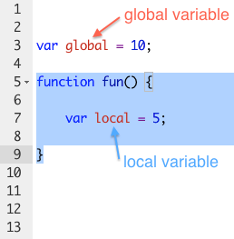
Scope –Global
Global scope of a variable, or Global variables are the variables declared in the program so that they can be accessed any time in any function.
Example
Variable named global can be used inside the function
.

Slide 28
Scope –Local
Local variables can not be accessed outside of the function they are declared in.
Example
Variable named local cannot be accessed outside the function

Slide 29
Scope – Global vs Local
function usaGas(){
var moneyiGetPaid = 100 ;
function ga(){
var moneyiGetPaid = 200;
console.log(moneyiGetPaid + "in ga");
}
console.log(moneyiGetPaid + " global");
ga(); //expected output is 200
}
usaGas();//expected output is 100
Global Variables
Local (block) Variables

Slide 30
Scope – let vs var
function var(){
var x = 1;
if (true) {
var x = 2; // same variable!
console.log(x); // 2
}
console.log(x);// 2 was the last recorded value, so 2 will be the output.
}
var();
Function Variables

Slide 31
Scope – let vs var
function let() {
let x = 1;
if (true) {
let x = 2; // different variable
console.log(x); // 2 is the value in the block.
}
console.log(x); // 1 is the last recorded value in the function.
}
let();
Block Variables

Slide 32
BONUS # 2 - Logical Question
Let’s take the cookie quarter challenge and extend it to all possibilities.
What if the cookie cost $2 and I paid with a 20?
hint: incorporate parameters

Slide 33
BONUS # 3 - Logical Question
Nando went to Uniqlo and bought himself a nice plaid shirt for $27.83. He paid with $100 as he had no change. The cashier paid in large denominations since they needed change for the other customers.
Write a loop that prints out how many bills he received in return in as large denominations as possible.

Slide 34
FizzBuzz
Write a program that uses console.log to print all the numbers from 1 to 100 with two exceptions. For numbers divisible by 3, print "Fizz" instead of the number, and for numbers divisible by 5 (and not 3), print "Buzz" instead. When you have that working, modify your program to print "FizzBuzz", for numbers that are divisible by both 3 and 5 (and still print "Fizz" or "Buzz" for numbers divisible by only one of those).
Notes:
Step 2 is functions, step 7 is objects

Slide 35
H.W
Code Academy - Steps 2 & 7
https://csx.codesmith.io/ CSX
Complete challenges:
Challenge: While Loops
Challenge: While Loops - Conditional Expression
Challenge: Control Flow - if statements
Challenge: Fizzbuzz/Fizzbuzz Solution
Notes:
Step 2 is functions, step 7 is objects

